Slide 1
Spectral Clustering

Slide 2
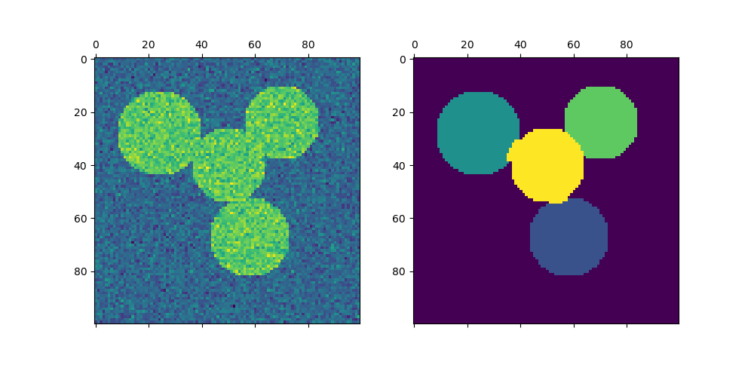
What is Spectral Clustering?
A type of clustering method used in machine learning.
Groups similar data points by analyzing a graph made from the data.
First, it creates a similarity graph and converts it into a simpler form.
Then, it uses another method (like KMeans) to create the final groups.

Slide 3
How Does It Work?
It works on a similarity matrix that shows how close points are.
Uses eigenvectors (math tool) to find patterns.
If the graph is clear and neat, clustering works better!
If the data is noisy, sometimes a heat kernel is used to fix the similarity matrix.

Slide 4
Key Points
You must tell Spectral Clustering how many clusters you want.
Works best for a small number of clusters (like 2 or 3).
Good for images — for example, separating objects from the background.

Slide 5
Example Uses
Image Segmentation: Splitting an image into parts (like separating coins from the background).
Graphs: Splitting a network or graph into smaller groups.

Slide 6
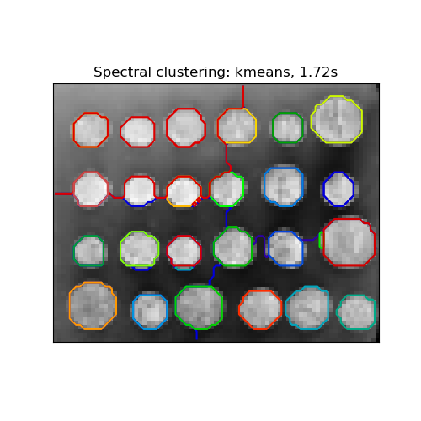
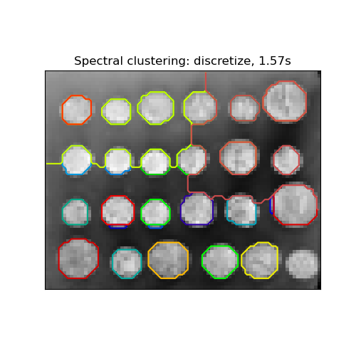
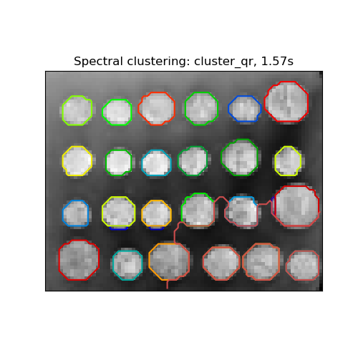
Different Label Strategies
kmeans: More details but can be unstable.
discretize: Always the same result but makes neat, even shapes.
cluster_qr: A newer method that gives clear, good-looking groups.
assign_labels="kmeans" | assign_labels="discretize" | assign_labels="cluster_qr"

Slide 7
Spectral Clustering on Graphs
Can be used directly on graphs by using the graph’s adjacency matrix.
Example:
python
CopyEdit
from sklearn.cluster import SpectralClustering
sc = SpectralClustering(3, affinity='precomputed', assign_labels='discretize’)
sc.fit_predict(adjacency_matrix)

Slide 8
What is Hierarchical Clustering?
Another clustering method that builds a tree of clusters.
Starts with every point in its own cluster.
Merges clusters step by step until one big cluster remains.

Slide 9
Types of Hierarchical Clustering
Ward: Tries to keep points in clusters close together.
Complete Linkage: Joins clusters by looking at the farthest points.
Average Linkage: Uses the average distance between all points.
Single Linkage: Uses the closest points to decide merging.

Slide 10
When to Use Hierarchical Clustering
Works well for small to medium datasets.
Can be slow for very big datasets if you don’t have extra info.
Can use a connectivity matrix to speed it up.

Slide 11
Thankyou

